Slide 1
Surveying the Cyberspace
Unit 1.2
Cybersecurity Boot Camp |

Slide 2
Today’s Theme

Slide 3

Today’s class in a nutshell.

Slide 4

Throughout this program, we will be diving into the weeds of many (often technical) topics. Learning these subjects will be important in developing hard-skills that you can leverage in your career…

Slide 5

…that said, hard-skills without context of the larger security landscape won’t be enough.

Slide 6
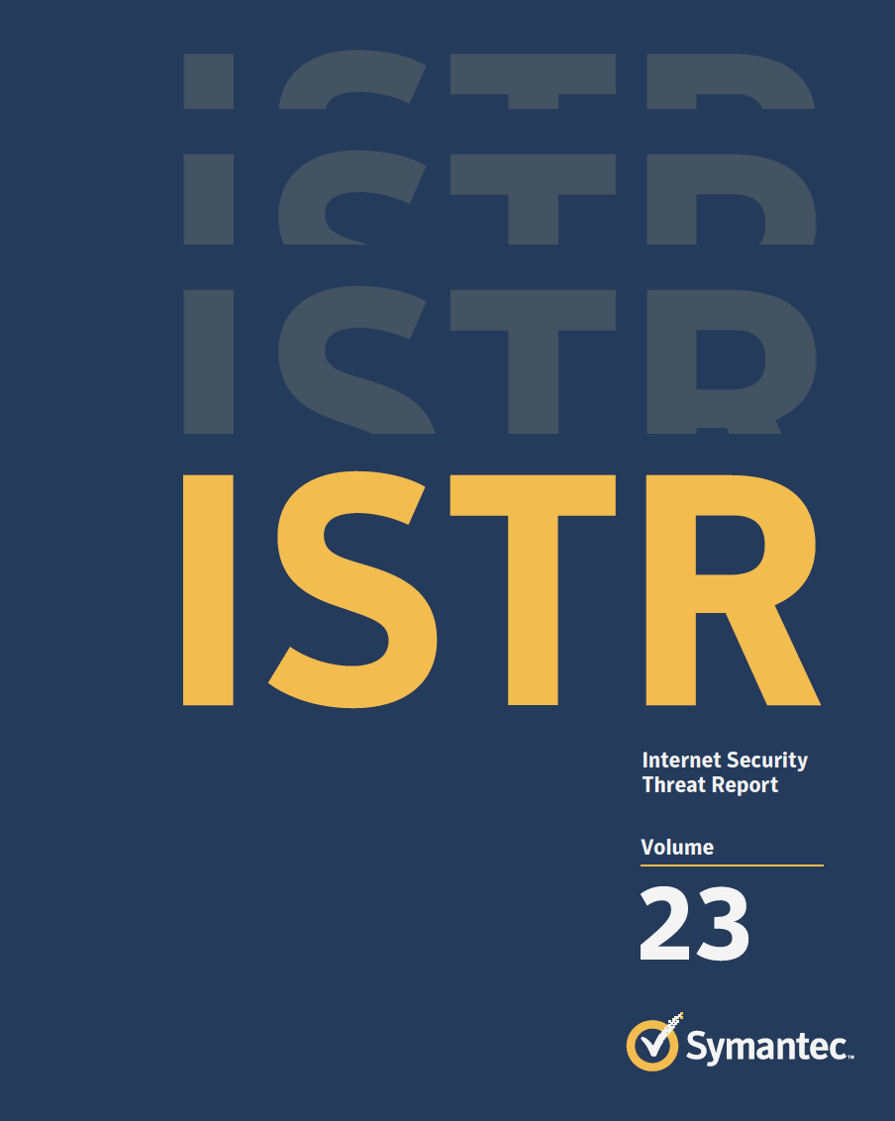
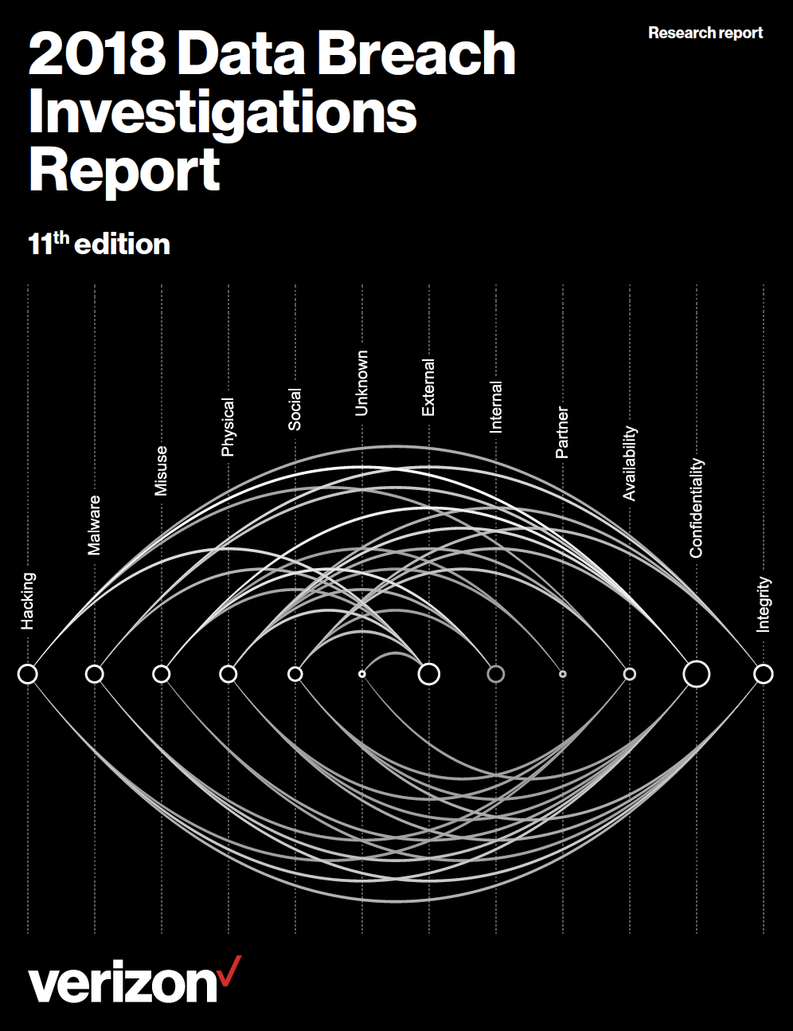
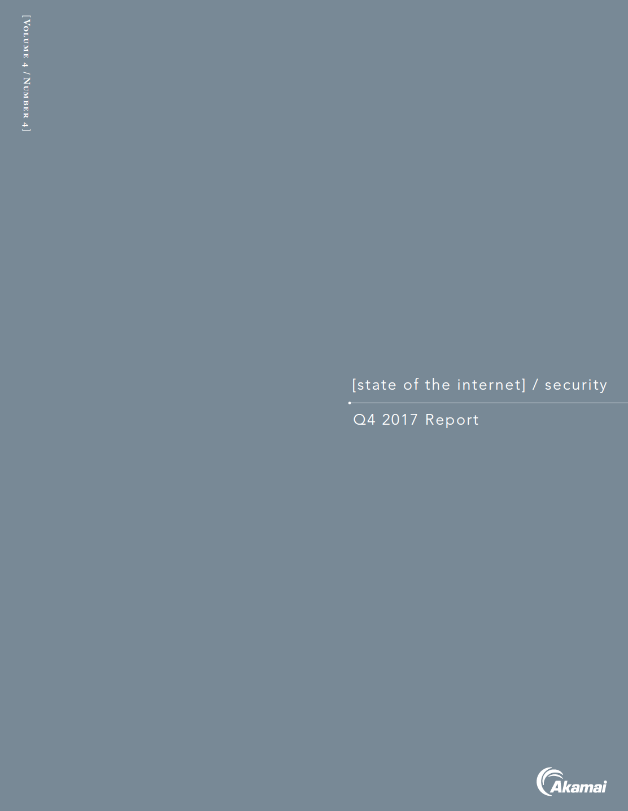
So in this class, we’ll be diving into the literature and getting you comfortable navigating the conversations cybersecurity professionals are having today.

Slide 7
Today’s Goals
By the end of class, you will be able to:
Articulate a clear definition of the CIA Triad and its elements.
Define and contextualize technical terms found in recent cybersecurity trend reports.
Utilize cybersecurity trend reports to communicate risk patterns in the current landscape.
Conduct and present analysis on a vulnerability, exploit, or threat actor to a non-technical audience using independent research.
Notes:
Review goals; address any questions.

Slide 8
Let’s start with a warm-up.

Slide 9
Quick Review

Slide 10
Quick Review!
Last class, we described cybersecurity as centering on two concepts.
What were they?
Notes:
Review goals; address any questions.

Slide 11
Quick Review!
Last class, we described cybersecurity as centering on two concepts.
What were they?
Threat Assessment
&
Risk Mitigation
Notes:
Review goals; address any questions.

Slide 12
Quick Review!
How would you define each of these terms?
Threat Assessment
Risk Mitigation
Notes:
Review goals; address any questions.

Slide 13
Quick Review!
How would you define each of these terms?
Threat Assessment
Structured process of identifying the risks posed to a group or system.
Risk Mitigation
Systematic reduction in the impact and/or the likely occurrence of a negative event.
Notes:
Review goals; address any questions.

Slide 14
Quick Review!
How would you define each of these terms?
Threat Assessment
What could happen??????
Risk Mitigation
How do we handle it?????
Notes:
Review goals; address any questions.

Slide 15
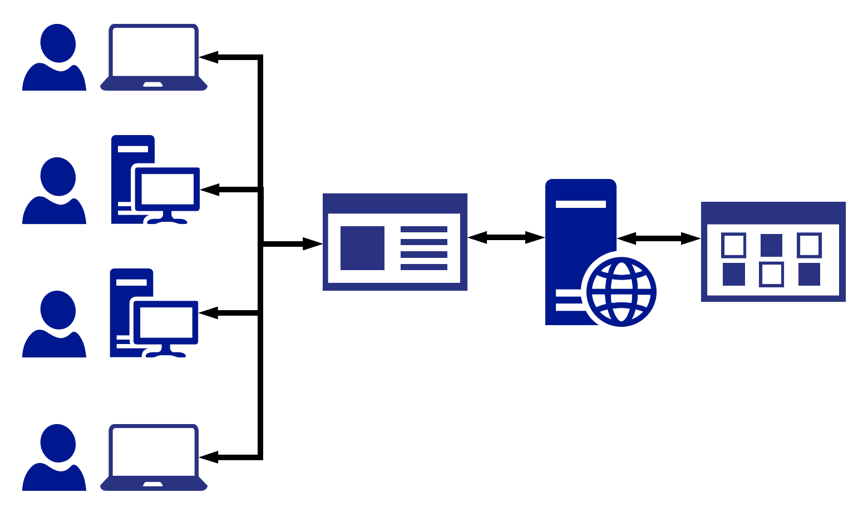
Quick Review!
Last class, we talked about a situation in which we were offering advice on a vulnerable login.
Web Login
Server
Data
Which elements of this diagram did we conclude were targets?
Users and Admins

Slide 16
Quick Review!
All of them
Web Login
Server
Data
In this case, an attacker could target EVERY node along the chain.
Users and Admins

Slide 17
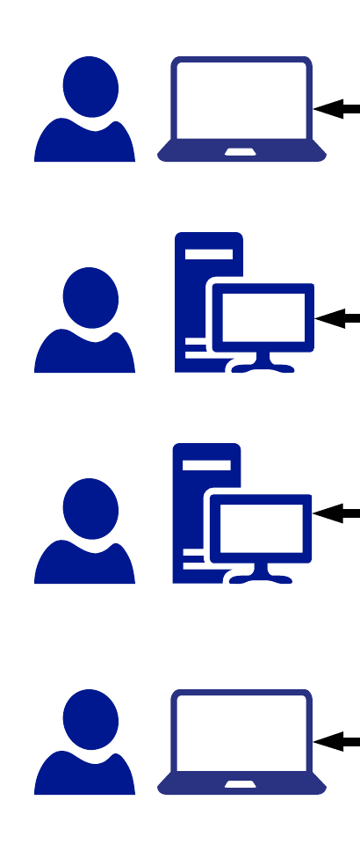
Quick Review!
Name Three
User Attacks
Notes:
Review goals; address any questions.

Slide 18
Quick Review!
Name Three
User Attacks
Social Engineering
Malware Attacks
Man In the Middle
Phishing Attacks
Packet Sniffing
Credential Reuse
Computer Theft
Notes:
Review goals; address any questions.

Slide 19

Quick Review!
Name One
Website Attack

Slide 20
Quick Review!
Brute Force Attacks
Code Injection
Faulty Sessions
Name One
Website Attack

Slide 21

Quick Review!
Name One Server Attack

Slide 22
Quick Review!
Name One Server Attack
OS Exploits
Code Loading

Slide 23

Quick Review!
Name One Database Attack

Slide 24
Quick Review!
Physical Break-Ins
Social Engineering
Cloud Security
Name One Database Attack

Slide 25
Quick Review!
User Attacks
Web Attacks
Database
Social Engineering
Brute Force Attacks
Physical Break-Ins
Phishing Attacks
Code Injection
Social Engineering
Credential Reuse
Faulty Sessions
Cloud Security
Malware Attacks
Server
Man In the Middle
OS Exploits
Name 3 Risk Mitigation Options
Packet Sniffing
Code Loading
Computer Theft

Slide 26
Quick Review!
Educate all users on dangers of phishing and social engineering
Ensure passwords are truly unique to website (require characters atypical of other websites).
Ensure users are using multi-factor authentication (login + phone confirmation).
Ensure administrators can only access the network from a secure location (on premises).
Ensure passwords used are strong (alphanumeric + symbols).
Ensure login fields do not accept any code insertions.
Ensure users are immediately signed off upon closing a browser. (No preservation of login after 30 seconds of inactivity).
Ensure all servers are routinely patched against latest known vulnerabilities.
Ensure physical access to servers is protected by multiple forms of authentication (login + biometric).
Ensure that all data stored in the database is encrypted and cannot be read without additional login information.
Ensure that all cloud security platforms follow best practices for security implementation.

Slide 27
And just for kicks…

Slide 28
Security Lessons are Everywhere…
Last night, as we were leaving the classroom we passed by a desk with TWO phones lying unattended.

Slide 29
Activity: “Oh Look. A Phone…” (7 min)
With the person sitting next to you, identify as many exploits possible in the event of a cell phone being stolen.
Hint: Be creative! Think like a hacker. What is the worst possible damage that could ensue. Try to do real damage. Think beyond the value of the phone itself.

Slide 30
Oh Look a Phone…
Potential Adverse Event
Cell phone can be wiped (cleared) and re-sold.
Cell phone memory can be harvested. Photos and sensitive material could be used for blackmail.
Credentials for email and social media accounts could be used to extract financial gain.
Installed applications could be used to make purchases.
Malware software could be directly installed to track future activity (without your noticing)
Contacts on your phone could be socially engineered into providing monetary value.
Your phone could be used to conduct illegal activity.
Your identity could be stolen.
Etc.

Slide 31
CIA Triad

Slide 32
The InfoSec Bible: The CIA Triad

Slide 33
Activity: Defining the Triad (5 min)
Working with the person next to you:
Take a few moments to define each element of the CIA Triad (Confidentiality, Integrity, and Availability) using a standard dictionary.
Then spend a few moments researching how these words translate in an information security context.
Finally, come up with 1-2 practical cases in which each element of the CIA triad could be impacted by an attack or breach.

Slide 34
The CIA Triad - Confidentiality
Confidentiality
Formal Definition:
The state of keeping or being kept secret or private.
IT Definition: Ensuring sensitive information does not reach unauthorized people.
Example of Attack:
Private photos or phone communication are released on a forum.
Credit card numbers are uncovered and exposed online.

Slide 35
The CIA Triad - Integrity
Integrity
Formal Definition:
The quality of being honest, whole, or undivided.
IT Definition: Integrity of information refers to protecting information from being modified by unauthorized parties.
Example of Attack:
Intercepted money transfer has the dollar amount changed to something insignificant – allowing the excess to be siphoned off.
Grades in a university record system are modified to a new (better) grade.

Slide 36
The CIA Triad - Availability
Availability
Formal Definition:
The quality of being able to be used or obtained.
IT Definition: Availability occurs when operating systems, equipment, and data are functioning correctly and accessible by those who need it.
Example of Attack:
Hackers take down a web connected generator in a hospital bringing down critical power supply.
Hackers use DoS attack to bring down a financial service provider’s website – making it impossible for clients to withdraw cash.

Slide 37
Threat Landscape

Slide 38
How to Understand the Threat Landscape?
For newcomers to the field it can be hard to quickly get to speed on the security landscape. There are a lot of threats, lot of technologies, and a lot of players.

Slide 39
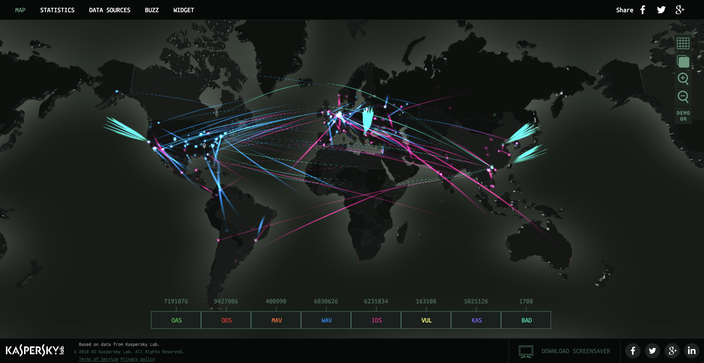
Cyber Attack Maps (Kaspersky)
Security maps like this one can be a nice visual way to see attacks happening in “real-time.”

Slide 40
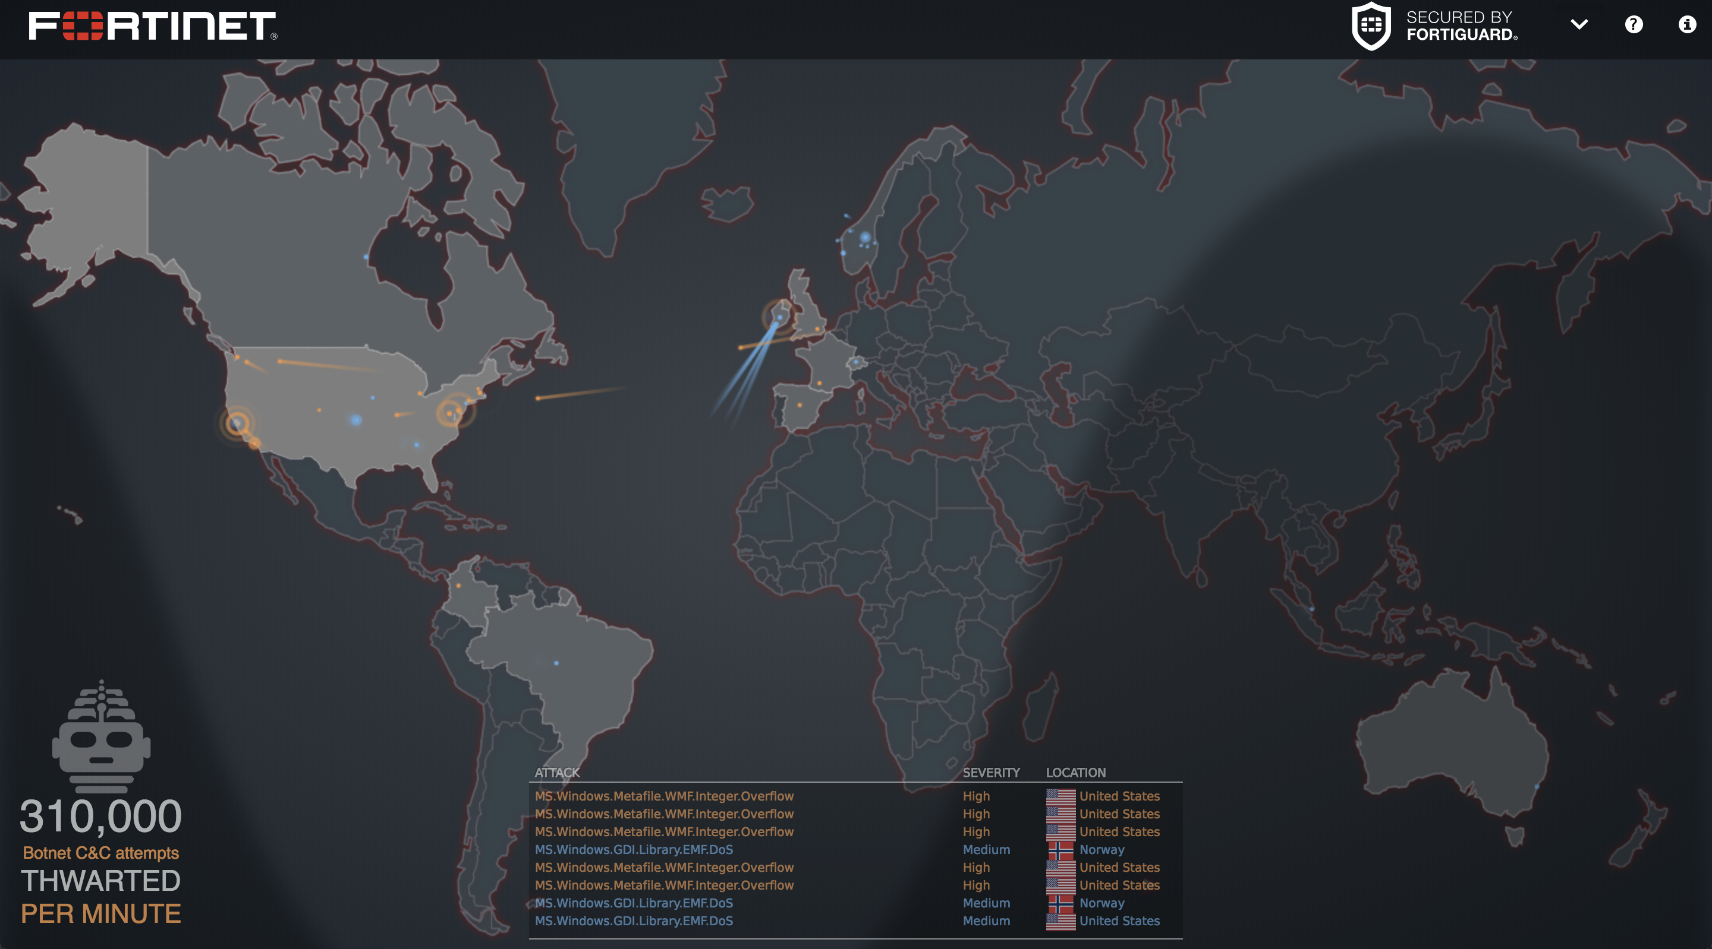
Cyber Attack Maps (Fortinet)
Security maps like this one can be a nice visual way to see attacks happening in “real-time.”

Slide 41
Activity: Attack Map Analysis (7 min)
Spend a few minutes playing around with the Kaspersky and Fortinet Threat Maps.
While on these websites answer the questions:
What exactly are these websites showing?
Are there any terms used on these websites that you are unfamiliar with? Find and define at least three.
Are there any trends that stick out to you? Look for at least two.

Slide 42
Threat maps are fun, but let’s be real…

Slide 43
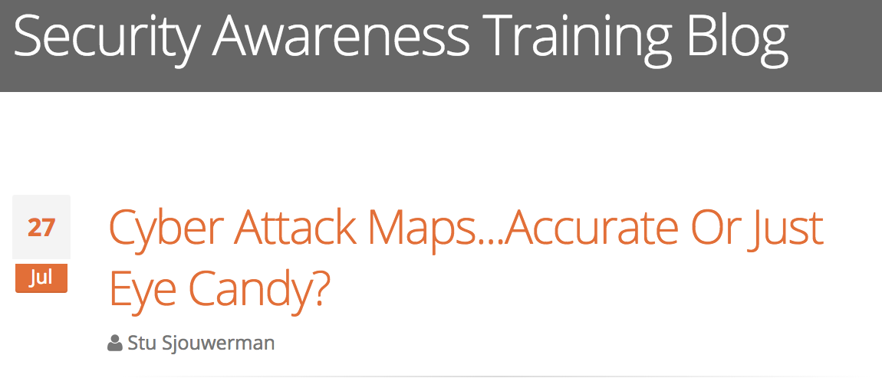
Attack Maps =/= Threat Landscape
Threat maps like the ones we just saw are largely considered visual eye candy and not a representation of the
threat landscape.

Slide 44






Credible Sources on Threat Landscape
https://krebsonsecurity.com/
https://www.schneier.com/
https://taosecurity.blogspot.com/
https://securityweekly.com/shows/
https://www.csoonline.com/
https://www.grahamcluley.com/
Most security professionals routinely turn to prominent reports, blogs, and whitepapers to stay abreast of the security field.
(You should start doing so as well!)

Slide 45
Security Report Analysis (Today’s Activity)
In today’s class, you will be using three prominent security reports to get a lay of today’s
security landscape.

Slide 46

Get Comfortable…
Sooo wish I were
hacking right now…
While today’s class will be a bit “report-heavy”. It’s important to realize that research and reporting are huge parts of the modern cybersecurity professional's responsibility.

Slide 47
Activity: Threat Landscape I - Vocabulary (15 min)
Working in pairs of two and using the reports provided complete the vocabulary report assignment.
Notes:
Be extra mindful in defining words in a way that a lay person would understand. Don’t rely on one technical term to define another. Break it down to a form you truly understand.
Use outside research when necessary to define the terms, but use the reports provided when explaining their significance. It’s important that you get comfortable reading technical documentation to draw out context.
Copy the assignment into a new Google Doc before getting started. You will be submitting this assignment later in the week as your first “homework” assignment, but but aim to complete at least the Symantec section by the end of class today.

Slide 48
Threat Landscape I - Vocabulary
Group Review
Notes:
Review goals; address any questions.

Slide 49
Activity: Threat Landscape II - Report Analysis (20 min)
Working in pairs of two and using the reports provided, complete the analysis assignment.
Notes:
For each questions, use a combination of the reports provided and your independent judgement to answer each question.
Again, remember to answer questions in a way that would make sense to a lay person when possible. Don’t feel content just writing down technical jargon.
Copy the assignment into a new Google Doc before getting started. You will be submitting this assignment later in the week as your first “homework” assignment, but aim to complete at least the Symantec section by the end of class today.

Slide 50
Threat Landscape II – Report Analysis
Group Review
Notes:
Review goals; address any questions.

Slide 51
Time for the best activity of the day!

Slide 52
Activity: Threat Landscape III - Security Report (20 min)
Working in pairs of three, you will be assigned a vulnerability, exploit, or threat actor. Your task is to: Prepare a 5-10 minute presentation that provides an overview of the topic, its significance, impact, risk mitigation, etc.
Notes:
See the more extensive instructions sent to you via Slack.
While you may be new to the field challenge yourself to “become the expert.” A huge part of being a security professional is getting up to speed quickly on technical situations using research.
For those uncomfortable about the idea of presenting, challenge yourself to treat this as a safe place. Becoming a confident speaker is an important part of being a cybersecurity consultant that people can trust.

Slide 53
Threat Landscape III – Security Report
Group Presentations?
Notes:
Review goals; address any questions.

Slide 54
Today’s Goals
By the end of class, you will be able to:
Articulate a clear definition of the CIA Triad and its elements.
Define and contextualize technical terms found in recent cybersecurity trend reports.
Utilize cybersecurity trend reports to communicate risk patterns in the current landscape.
Conduct and present analysis on a vulnerability, exploit, or threat actor to a non-technical audience using independent research.
Notes:
Review goals; address any questions.

Slide 55
Next Class

Slide 56
Next class, we’ll spend some time discussing the variety of domains and career pathways available in the security field.

Slide 57
Questions / Discussion

